Slide 1
The University Writing Center
Improving Our Responses to Student Writing
Notes:
Hello, my name is.... I’ve been working at the writing center for (amount of time). Today, I’m going to talk to you about improving our responses to student writing.

Slide 2
Land Acknowledgment
We would like to acknowledge that we are meeting on Indigenous land. Moreover, we would like to acknowledge and pay our respects to the Carrizo & Comecrudo, Coahuiltecan, Caddo, Tonkawa, Comanche, Lipan Apache, Alabama-Coushatta, Kickapoo, Tigua Pueblo, and all the American Indian and Indigenous Peoples and communities who have been or have become a part of these lands and territories in Texas, here on Turtle Island.
Notes:
[READ SLIDE] Pronunciation guide for tribes: Ka-REE-zo, Com-uh-CREW-doe, Ko-hweel-TECH-un, KAH-doe, Ton-KAH-wa, Koh-MAN-chee, Lee-PAN Uh-PA-chee, Al-uh-BAM-uh Koo-SHA-tuh, KIK-UH-poo, TEE-gwuh PWEH-blow

Slide 3
About the UWC and Our Services
One of the largest writing centers in the country
10,000-12,000 consultations annually
Provide 45-minute, one-on-one consultations for undergraduate and graduate students
Conduct presentations in 100+ classrooms each year
Facilitate writing groups and writing retreats for graduate students
Participate in workshops like this one
Notes:
[Read slide] Also, you can explain that we anticipate that our annual consultation numbers will be growing as we transition to offering both online and in-person consultations.

Slide 4
Objectives
To share with you some of the challenges students face when they receive feedback
To offer suggestions for improving the kind of feedback you provide student writers and maximize your efficiency in grading
To give you a clearer picture of what students experience when they come to the writing center
Notes:
[Read Slide]

Slide 5
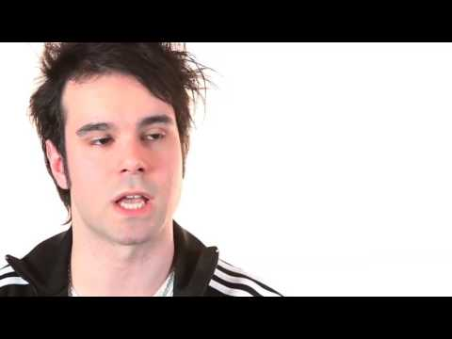
Problems Students Experience with Feedback
Nancy Summer’s “Beyond the Red Ink: Teachers’ Comments through Student Eyes,” a Bedford/St. Martins Production posted by Macmillan Learning
Notes:
Ask faculty to reflect on what stood out to them about the video. Most likely, their answers will lead to a discussion about student vulnerability around writing. You might emphasize that instructor feedback can be instrumental in facilitating student growth when students are properly supported. You might also ask what the students in the video identified as their expectations from instructor feedback.

Slide 6
Being Unsure of
How to Interpret Your Shorthand
AWK
// AGR
# ???!
✔
Notes:
Students often encounter puzzling abbreviations in the comments on their graded papers. Which of these symbols are you familiar with? Which are new to you? If you’ve worked with proofreaders in the past, you may be familiar with some of these editing marks, but you have to remember that students likely won’t know what these mean. AWK means awkward. // indicates an error in parallelism. AGR signifies a problem with agreement (could be subject-verb agreement or pronoun-antecedent agreement). # is the editing mark for a space, though students these days would likely associate it with a hashtag, so you can imagine how mystifying they would find its presence on their graded paper. I can only imagine that ???! would convey strongly felt confusion. The take-away here is that if you insist on using editing marks, make sure to provide your students with a key for the symbols. Better yet, avoiding editing symbols altogether in favor of something more familiar to your students, and something that doesn’t suggest you’re in a hurry.

Slide 7
Being Unsure of
How to Interpret Suggestions
What does he mean when he says this paragraph needs to be clearer?
What does she mean when she says I’m being vague?
Notes:
Sometimes students feel unsure of how to interpret suggestions on their papers. For example, they may ask, “What does he mean when he says this paragraph needs to be clearer?” or “What does she mean when she says I’m being vague?” The problem here is that many different elements of the writing could be what the instructor is calling unclear or vague, such as the word choice, the sentence structure, or the paragraph organization. These comments don’t tell a lot about the reader’s experience of reading the paragraph. It would be better to convey a fuller sense of that readerly experience in a longer end note rather than dashing off short and potentially perplexing comments in the margins.

Slide 8
Being Unsure of What to Prioritize
To a student, all margin comments can seem to be equally important.
This can lead to a revision that prioritizes local issues (e.g.: spelling, grammar) rather than global ones (e.g.: thesis, idea development, support)
Notes:
Another problem that may arise for students in interpreting instructor feedback is being unsure of what to prioritize. When an instructor just comments in the margins as they read the paper, the end result can be an abundance of marginal comments. Faced with such marginal comments, students will often conclude that all the comments are of equal importance. That can actually encourage students to prioritize local issues, such as sentence-level problems with spelling or grammar, rather than the global issues that tend to matter more to instructors, such as thesis an, support, and idea development. And it makes sense that students would start with the local fixes since these are often more straightforward and quicker to address. So we need to keep in mind when giving students feedback that we want to place emphasis on the most important revision moves.

Slide 9
What You Can Do to Improve Students’ Experience with Feedback
Minimize marginal comments. Write a final comment that summarizes your response and suggestions.
Consider whether to begin with a general comment that applies to all the papers in the class, before tailoring your feedback for this student and paper.
Prioritize global over local issues. Use minimal marking for local issues.
Notes:
An end note gives you much more space to convey what you think should be the student’s priority in revising. For local issues, using minimal marking can be a way to make clear that the global issues should be the student’s priority. Minimal marking, as I’ll discuss in more detail in just a minute, is a system in which the instructor identifies patterns of errors instead of specific instances of that error. Basically, the instructor flags a couple of instances of the error and then uses the final comment to draw the student’s attention to the pattern.

Slide 10
Notes:
This spectrum lets you know how particular writing issues register on the scale of global to local. At the UWC, one of the most frequent and important issues we encounter in our consultations is responding to the prompt. Students often come to the UWC for support in ensuring that their papers have fully addressed the concerns of the paper prompt. This global issue tends to be the top priority of most instructors as well. Our point is that if your feedback to the student dwells too much on local issues, students can end up confused about what is really important in their revision.

Slide 11
Notes:
Minimal marking is a strategy developed by Richard Haswell. His method is to use check-marks in the margins to indicate a local issue. You could do that or use a modified version in which you highlight the specific issue in lieu of the check-mark. The main idea here is to flag just a few instances of the issue and then draw the student’s attention to the pattern of error. This allows students to have a learning opportunity that is not available to them if you simply correct ever instance of the error for them.

Slide 12
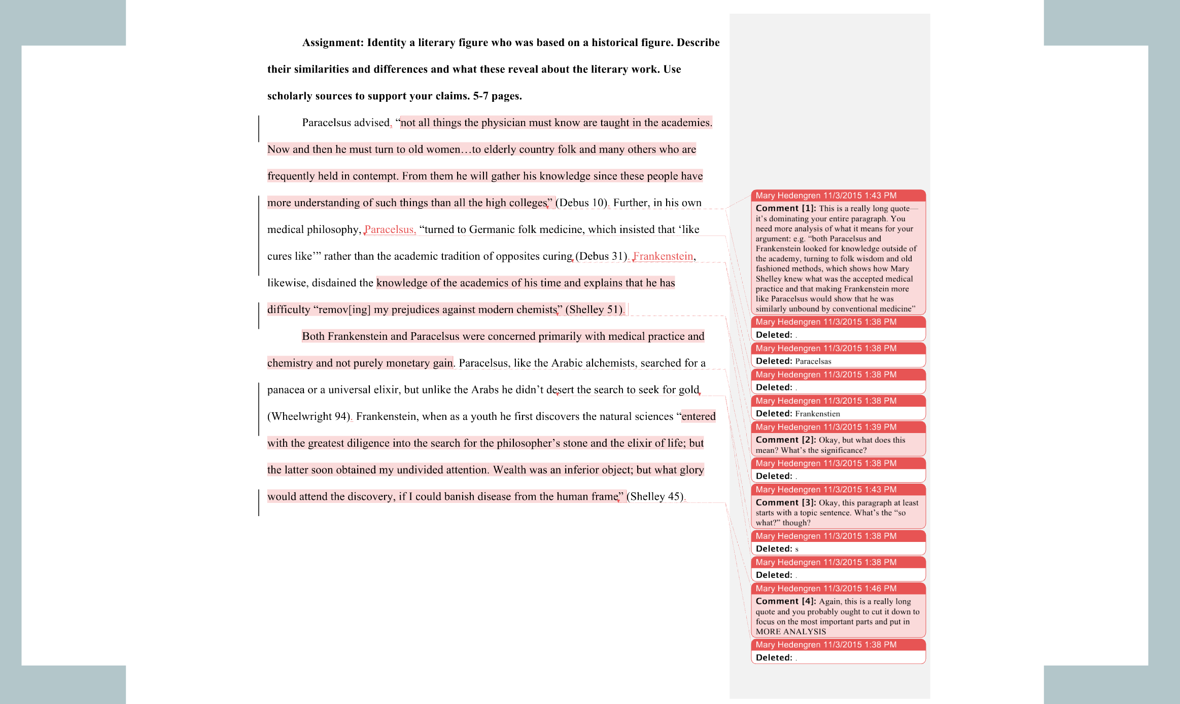
Notes:
This is an example of a paper with heavy marginal feedback. When faced with feedback like this, students can find it hard to know what’s important, and they can feel overwhelmed by a wall of comments.

Slide 13
Assignment: Identify a literary figure who was based on a historical figure. Describe their similarities and differences and what these reveal about the literary work. Use scholarly sources to support your claims. 5-7 pages.
Paracelsus advised “not all things the physician must know are taught in the academies. Now and then he must turn to old women…to elderly country folk and many others who are frequently held in contempt. From them he will gather his knowledge since these people have more understanding of such things than all the high colleges.” (Debus 10) Further, in his own medical philosophy, Paracelsas “turned to Germanic folk medicine, which insisted that ‘like cures like” rather than the academic tradition of opposites curing. (Debus 31) Frankenstien, likewise, disdained the knowledge of the academies of his time and explains that he has difficulty “remov[ing] my prejudices against modern chemists.” (Shelley 51)
Both Frankenstein and Paracelsus were concerned primarily with medical practice and chemistry and not purely monetary gain. Paracelsus, like the Arabic alchemists, searched for a panacea or a universal elixir, but unlike the Arabs he didn’t dessert the search to seek for gold. (Wheelwright 94) Frankenstein, when as a youth he first discovers the natural sciences “entered with the greatest diligence into the search for the philosopher’s stone and the elixir of life; but the latter soon obtained my undivided attention. Wealth was an inferior object; but what glory would attend the discovery, if I could banish disease from the human frame.” (Shelley 45)
End notes: It looks like you found some great resources, but they dominate the paper. Add more analysis: why is it significant that Paracelsus and Frankenstein share these similarities, for example in accepting folk medicine as well as traditional medicine? Check your MLA format—periods belong at the end—and proofread carefully, especially names.
Notes:
Here is the same piece of writing, but now the feedback uses minimal marking and a final comment. As you can see in the end note, the emphasis is on global issues. The patterns of local errors does get addressed, but it is de-prioritized by getting less of space devoted to it in the end note.

Slide 14
What You Can Do to Improve Students’ Experience with Feedback
3. Avoid simple judgments (“good,” “bad,” etc.). Frame your assessment in terms of expectations for the genre, assignment, or audience.
Let them know: when they’ve met or what they need to do expectations to meet them
4. Describe your experience reading the paper. The information you provide will help students understand how to think about their readers’ needs.
Notes:
Another suggestion for improving feedback is to avoid framing your suggestions in moralizing terms by using words such as “good” or “bad.” In academia, typically the language we expect students to use is Academic Edited English. This form of English doesn’t really correspond to any spoken form of the language, but the closest spoken form to it is that of upper class Anglo-Americans. So a lot can be at stake in judging a particular use of language as bad. At the UWC, we suggest framing your assessment in terms of genre, assignment, or audience expectations. If students meet those expectations, it is important to let them know that. If they don’t, try to give them some specific suggestions for how to do so. In your final comment, you have space to describe your experience of reading the paper, which can help students understand how their work is received by an audience. That might be what they need to transition their writing from the more writer-based prose typical to early drafts, in which the student is primarily writing to discover their own thoughts on a subject, to writing that takes the audience into account.

Slide 15
Responding in Various Modalities
Canvas
Students are familiar with it
Provides a Comment box where you can conduct a conversation about the student’s paper
Make use of the rubric function
Have them to tell you what they want the most feedback on
Ask questions about points that confused you as you read
Get them to describe their revision process across drafts
Google Doc
Students are familiar with it
Simpler interface than Canvas
Allows for discussion in margins
Ask students to use track changes so you can see revisions easily
Assists in the revision process by encouraging students to work through a “living” document

Slide 16
Aside from responding in writing...
Set up conferences to discuss first drafts. Ask questions that will help you offer targeted feedback:
“What is the thesis?” or “What part of the draft do you think needs the most work?”
Experiment with audio notes, video commentary, and other means of responding to students’ writing.
Encourage (but please don’t require) your students to visit the UWC.
Notes:
If you are able to offer students writing conferences, that can be a way to approach feedback that allows for a more dynamic exchange. And some instructors use audio or video commentary to respond to student writing. For students, just hearing their paper read aloud can help them identify problems, so encouraging (but not requiring) students to come to the UWC, where we typically read student writing before having a conversation about it, can be a great resource.

Slide 17
The UWC Philosophy
We tell every student that we are:
Non-directive & Non-evaluative
This approach allows us to be more emotionally sensitive to the students’ needs and helps to create a more relaxed environment.
Notes:
At the UWC, we practice giving non-directive and non-evaluative feedback. It’s non-directive because students set the terms for the session by telling us what their goals are and what they’d like to focus on. In the session, we avoid evaluative framings as we respond to student writing, so rather than identifying what is good or bad in the writing, we tend to ask questions about what the expectations of the assignment are. We’ve found that students can really relax when we approach their writing this way since we are showing students that we are sensitive to their needs and that we want to offer support.

Slide 18
Feedback
Directive & Evaluative Non-directive &
Non-evaluative
Grading Diagnosing
Proofreading Showing Examples Questioning
Editing Modeling
Giving Options
“As a reader, I find your thesis confusing. Will your instructor?”
“Here are models of different kinds of thesis statements. Which one jibes with what your instructor wants?”
“According to this model, what could you change about your thesis statement to make it meet those expectations?”
“This is a ‘D’ level thesis statement. Include X and Y in yours to make it better.”
“What kind of thesis does your instructor want? Will it satisfy your instructor?”
Notes:
As you can see on this slide, there’s a spectrum of directive and evaluative to non-directive and non-evaluative. Even though as graders, instructors tend to be on the directive and evaluative end, they can still benefit from many of the approaches in the middle or right side of the spectrum, such as raising questions, modeling, or showing examples.

Slide 19
Questions?
Notes:
Ask the audience if they have any questions, and field these.

