Slide 1
Writing Centers as the Center of Writing: Democracy as Revision

Slide 2
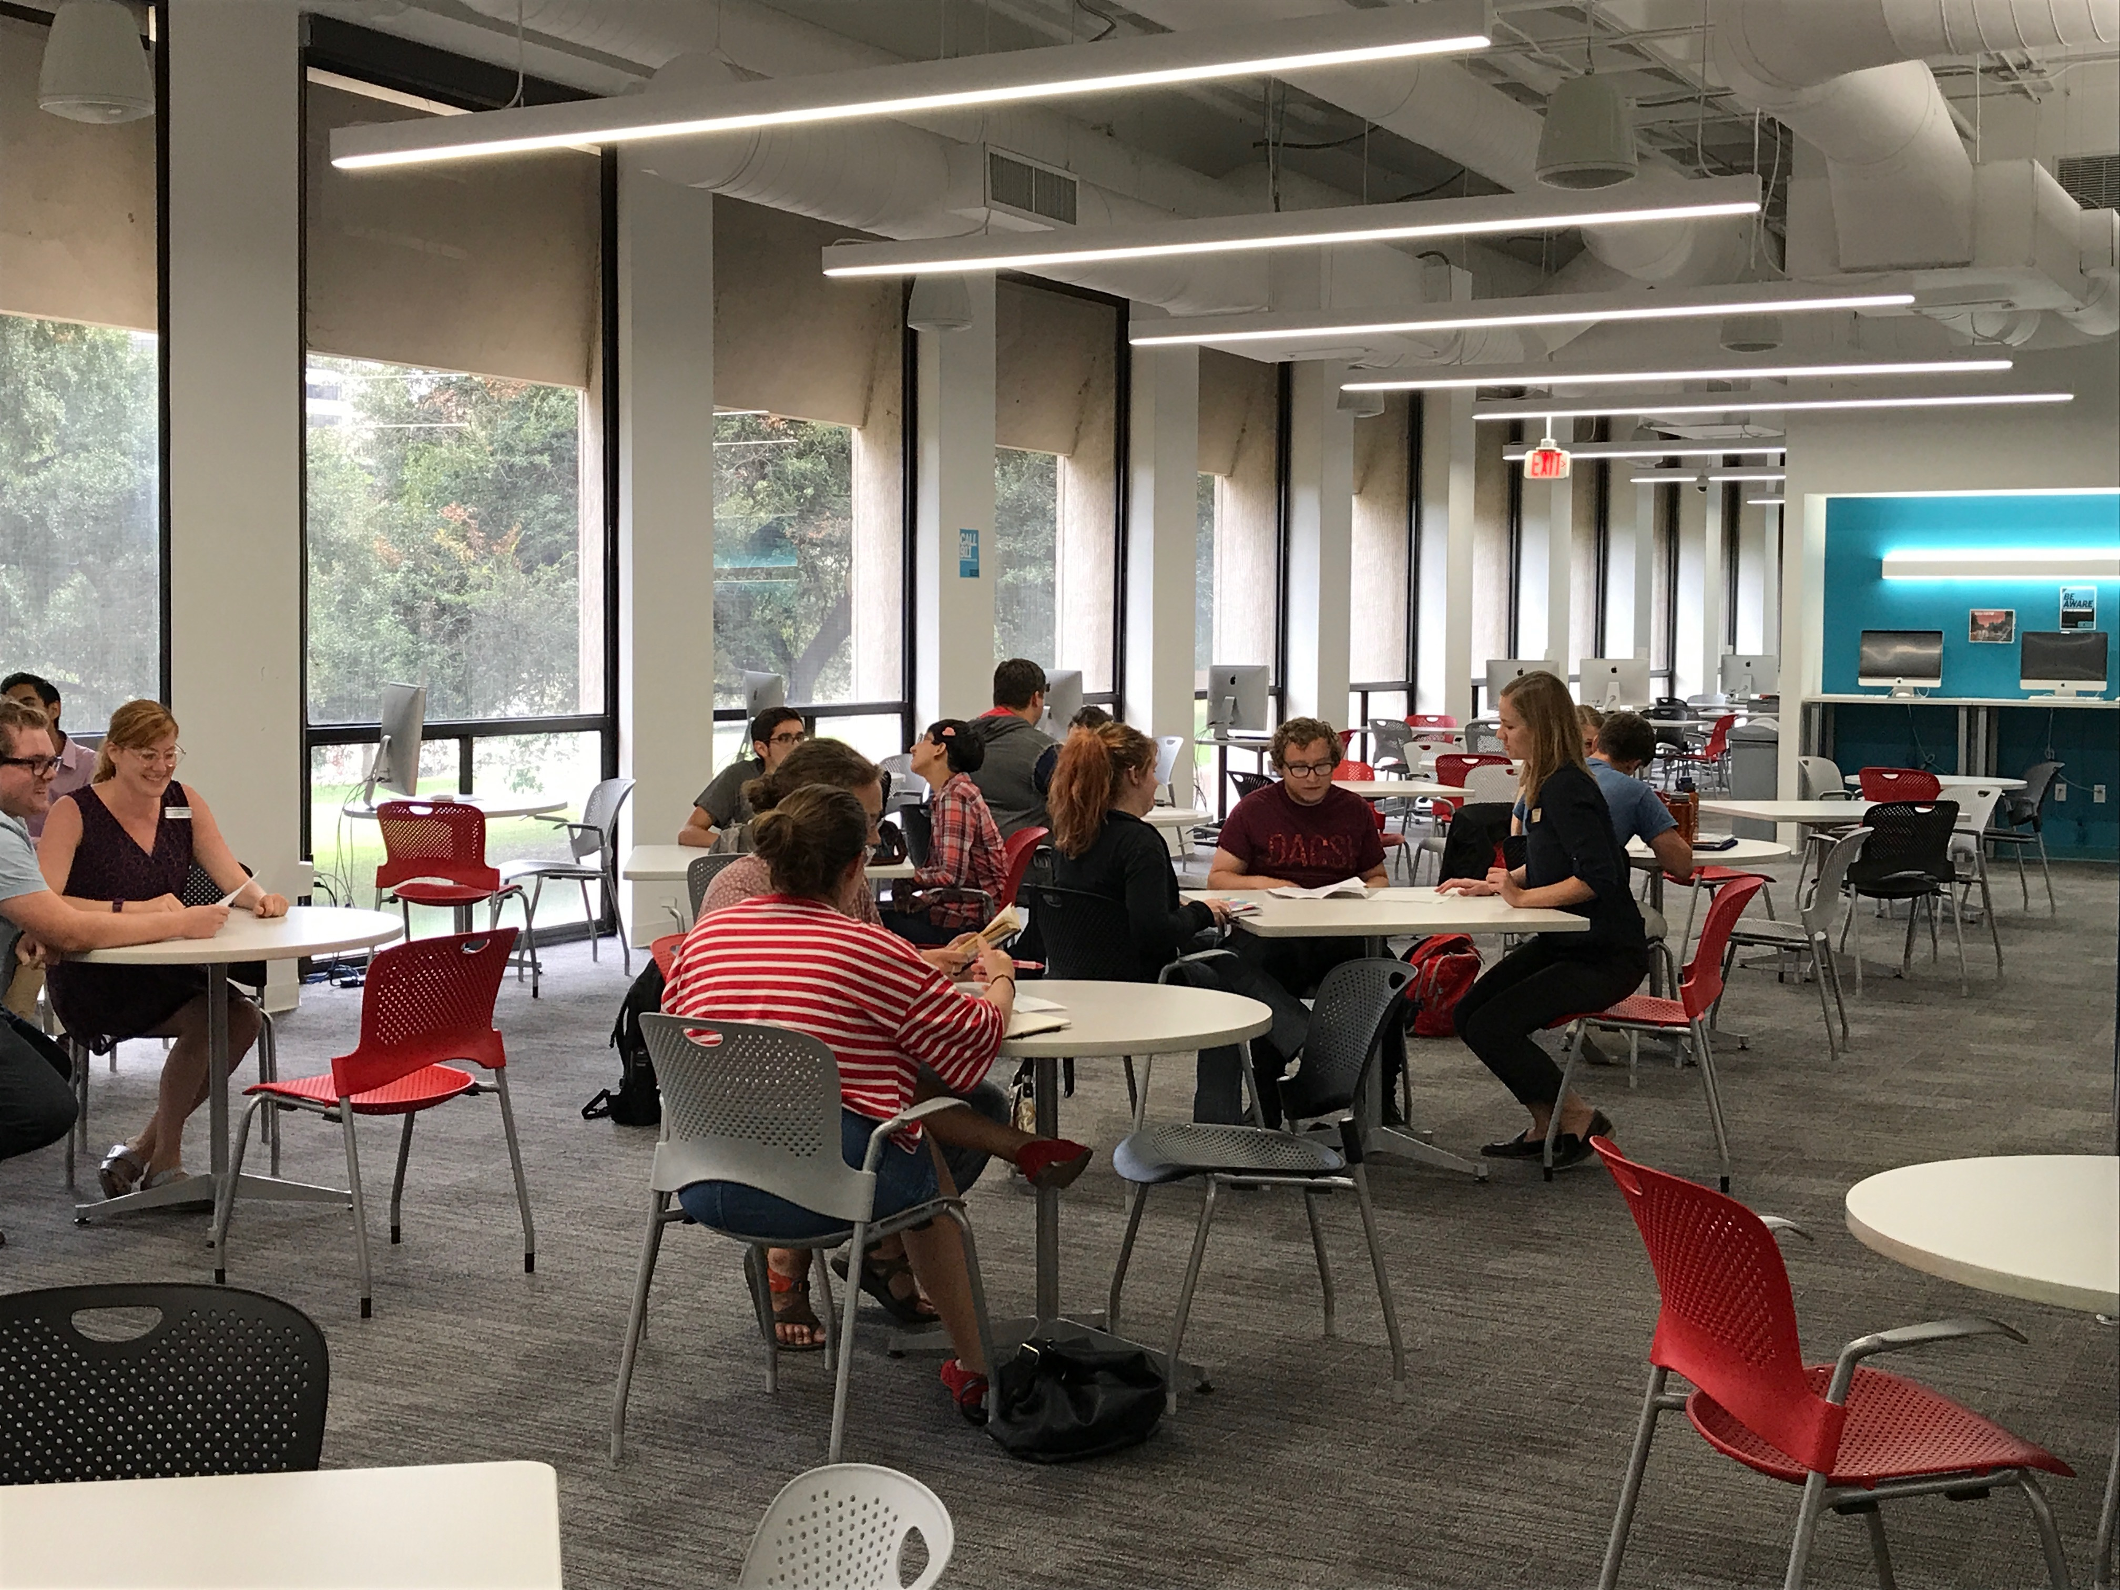
Students and Consultants at the UWC

Slide 3
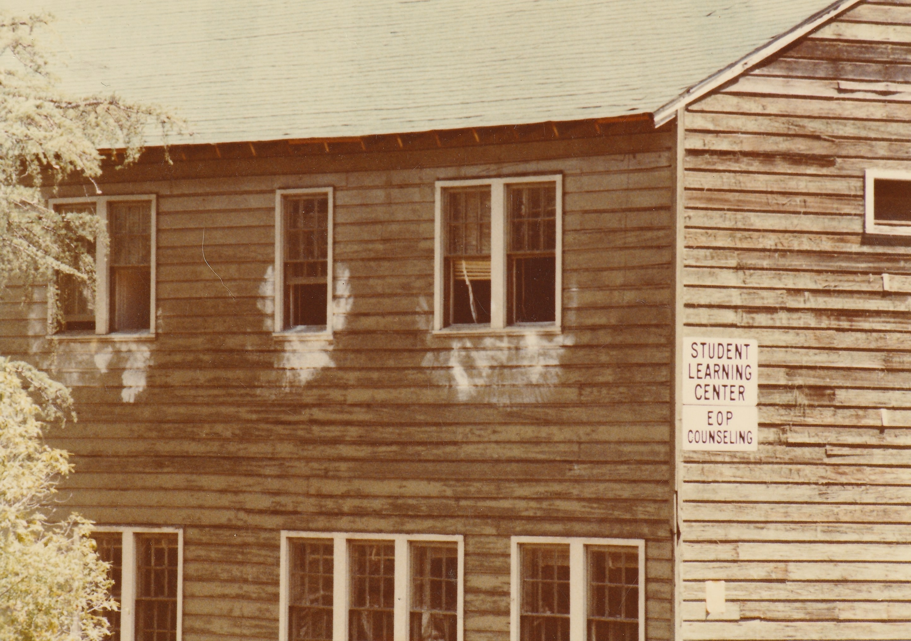
Student Learning Center

Slide 4
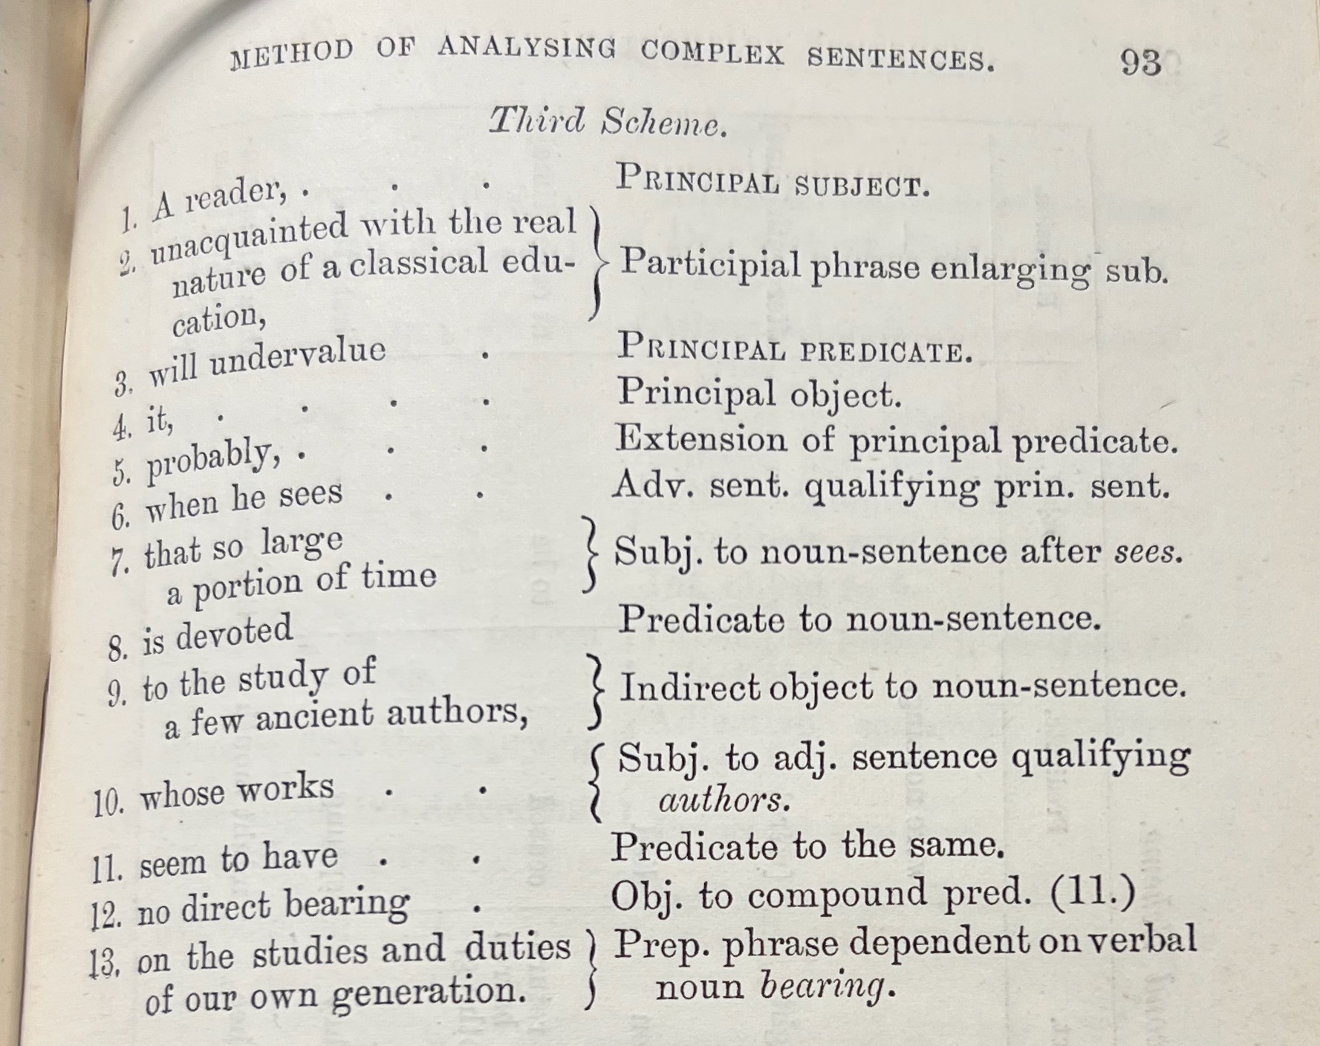
Method of Analyzing Complex Sentences

Slide 5
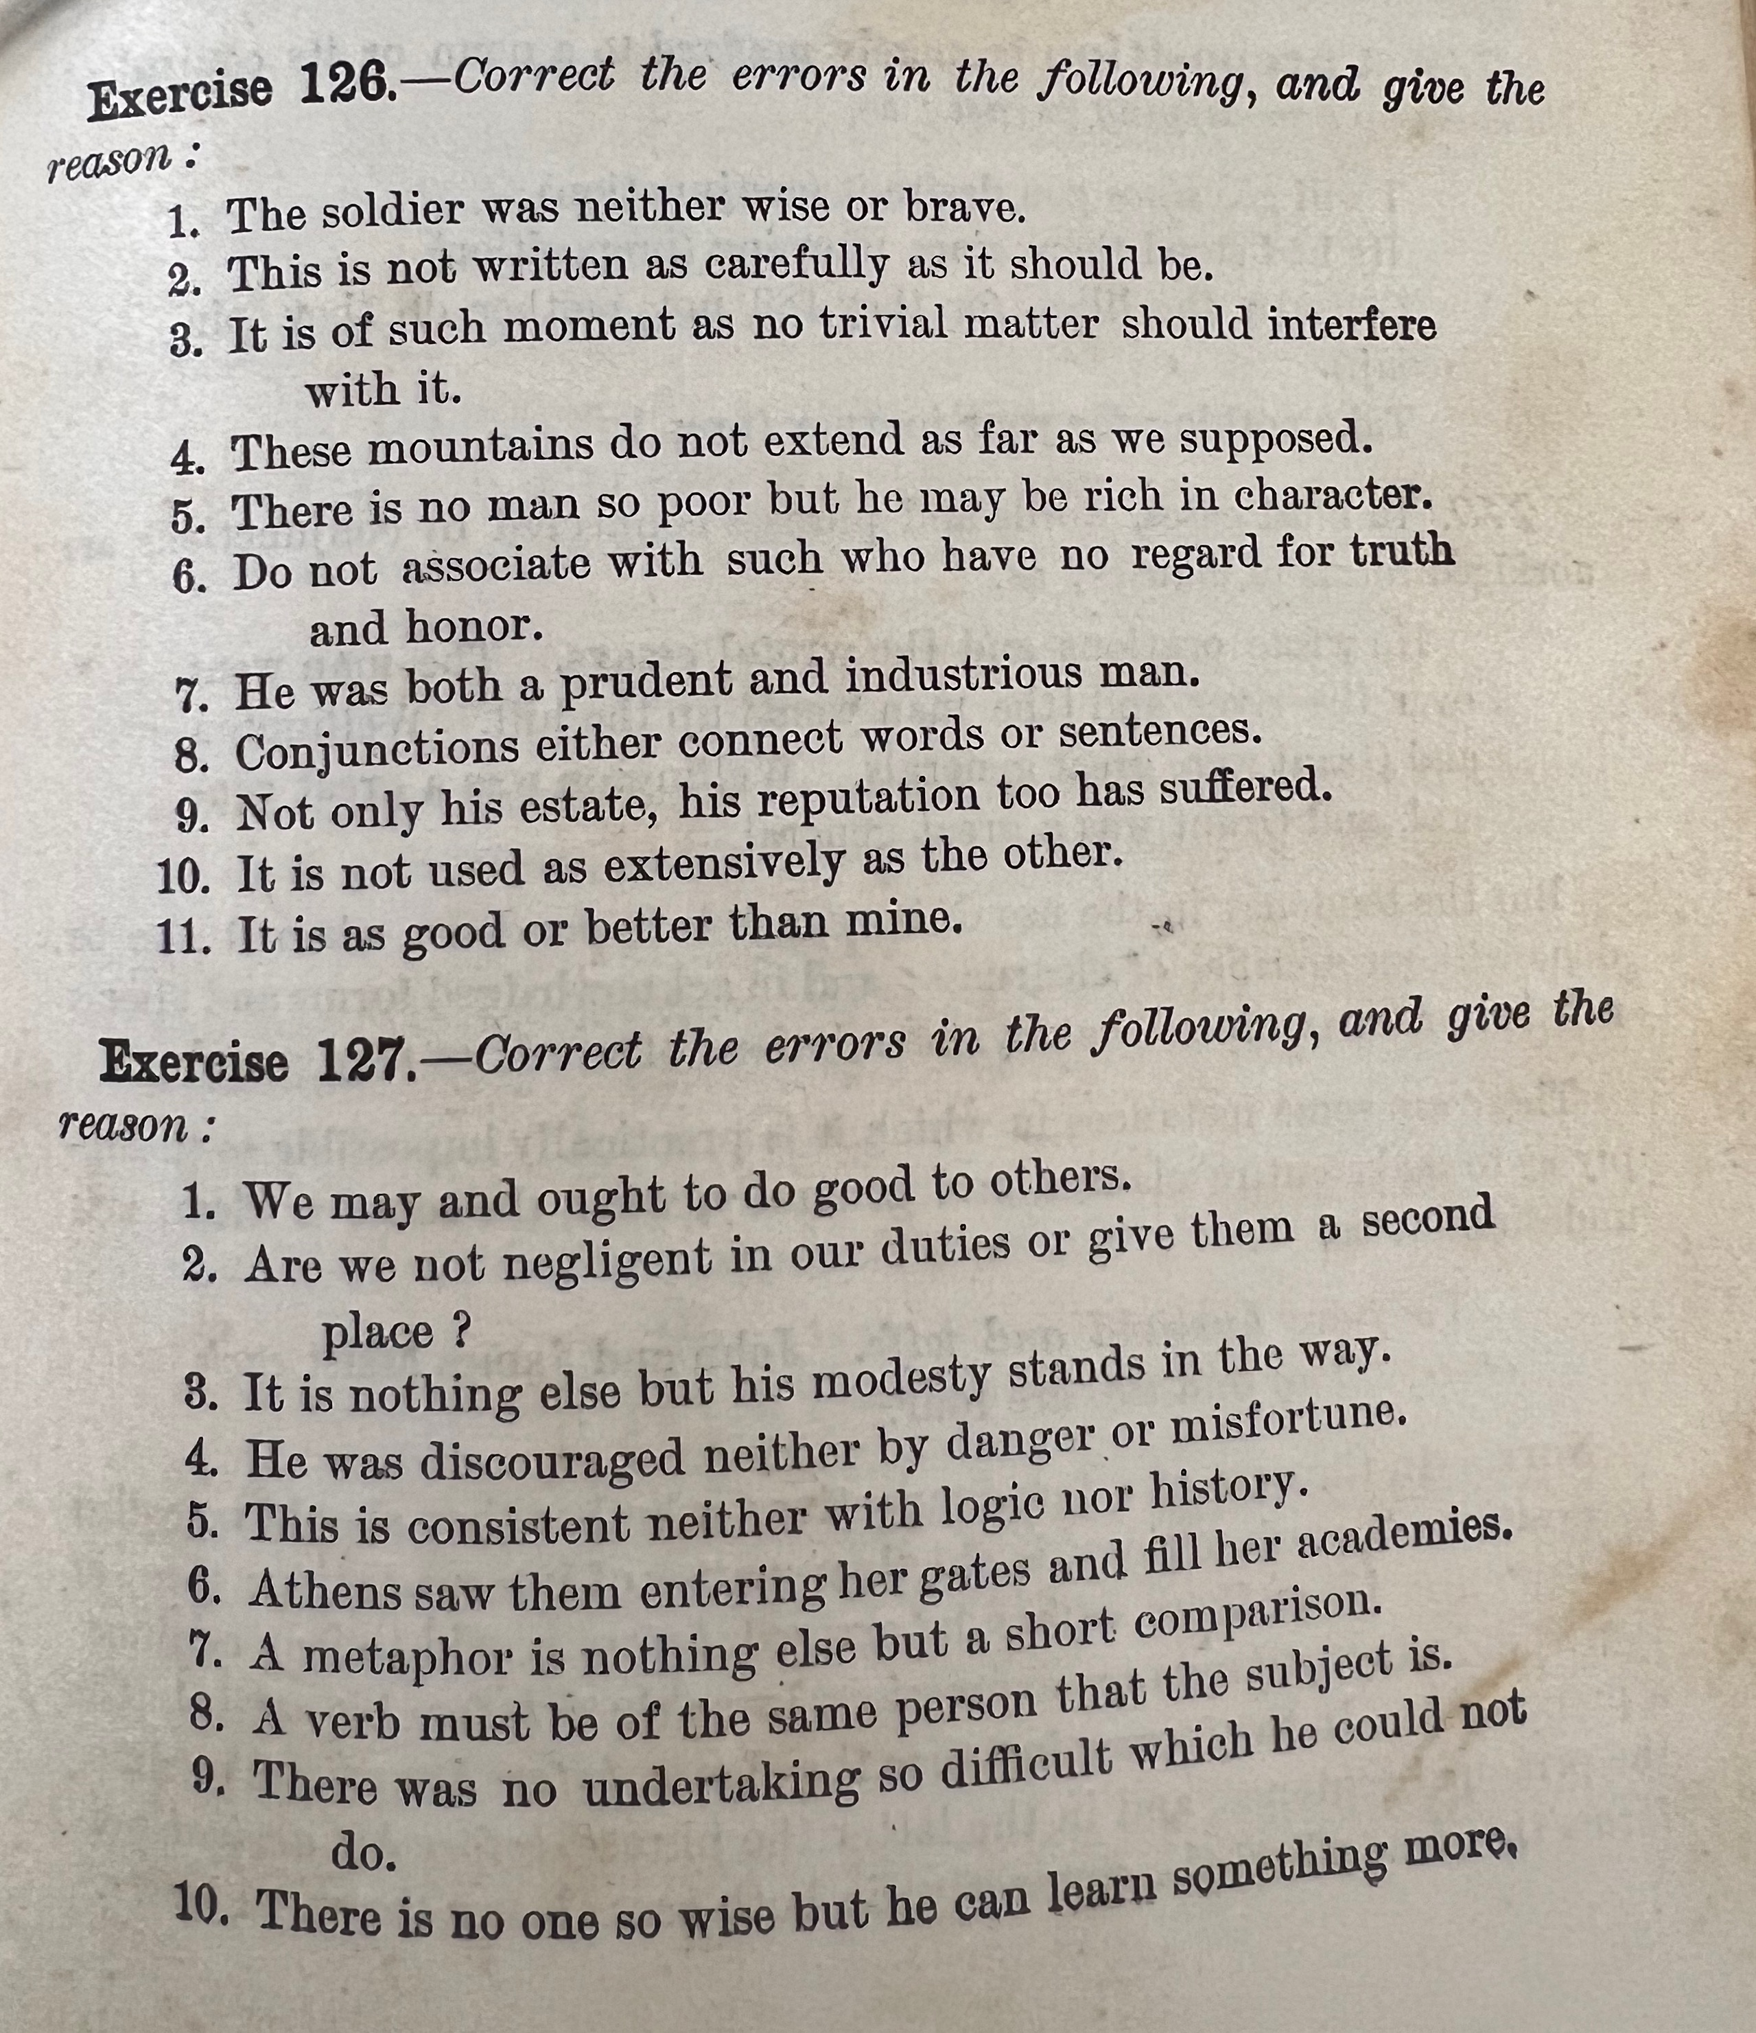
Example Exercises

Slide 6
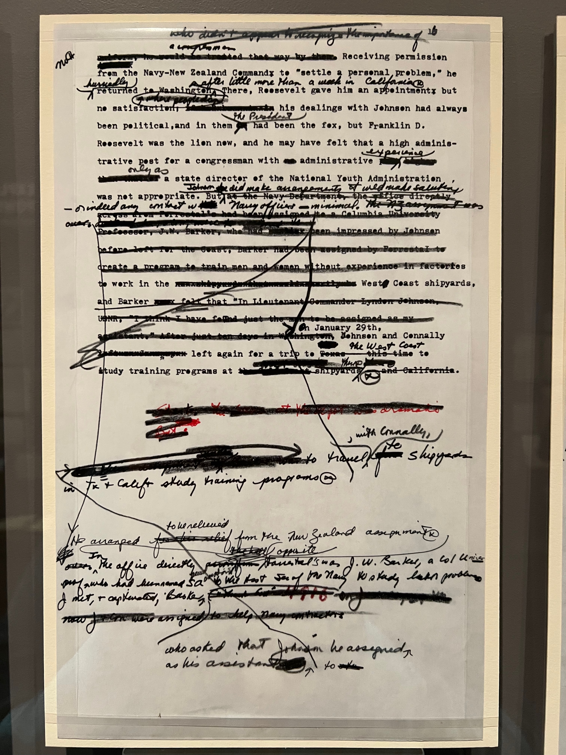
Example Essay #1

Slide 7
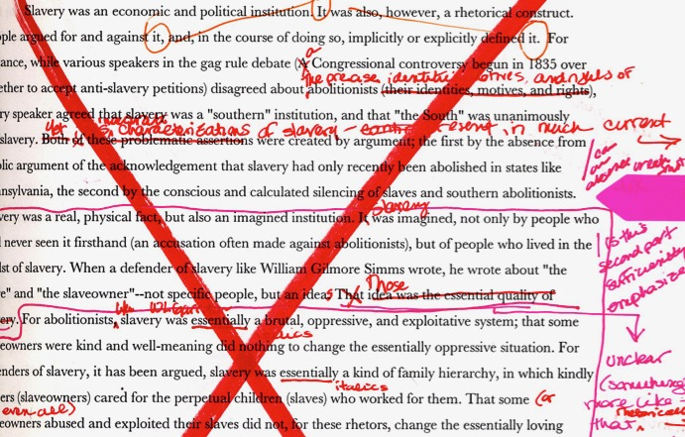
Example Essay #2

Slide 8
Student Learning Center and the UWC

